Slide 1
Tax Payments Made & Credits
Pub 17 Chapter 4
(Federal 1040-Lines 64-74)
(NJ 1040-Lines 48 & 50)
Notes:
1

Slide 2
Types of Payments & Credits
Can be applied against tax liability
Federal and NJ
Income tax withheld from W-2s, W-2Gs, 1099s, etc.
Estimated tax payments
Amounts applied from prior year’s return
Payments made with a request for extension of time to file
Earned income credit
Federal Only
Additional child tax credit
Refundable American Opportunity credit
NJ Only
Property Tax Credit
Excess UI / DI / FLI
Notes:
2

Slide 3
Income Tax Withholding – 1040 Line 64 / NJ 1040 Line 48
Collected by employer
Set aside from pensions, Social Security
Set aside from bonuses, commissions
Set aside from gambling winnings
TaxSlayer – automatically totals from data entry for individual forms & populates on 1040 Line 64 or NJ 1040 Line 48
Notes:
3

Slide 4
Estimated Tax Payments – Federal 1040 Line 65 / NJ 1040 Line 50
Means of tax payment for:
Self-employed
Those with investment income
Projected Federal balance due > $1,000; projected NJ balance due > $400
Payments made periodically by taxpayer (usually due on 4/15, 6/15, 9/15 and 1/15 of subsequent year - may change due to holidays)
Need to know “When” & “How Much” for each 2016 estimated tax payment made
Estimated tax payments are mailed in separately from tax return
Particularly important for payment due 4/15
Notes:
4

Slide 5
Overpayment From Previous Year
Could have elected to have 2015 refund applied to 2016 tax liability for both Federal and NJ
Ask taxpayer if 2015 refund was applied to 2016 taxes or check Federal and NJ 2015 tax returns
Notes:
5

Slide 6
NJ Estimated Taxes Paid and Amount Applied from Prior Year
Enter in Federal Section \ Payments and Estimates \ State Estimated Payments
Report:
2016 NJ estimated tax payments paid in 2016 or January 2017
Enter final 2016 estimated tax payment on proper line depending on whether it was paid before end of 2016 or in January 2017
Refund from 2015 tax return applied to 2016
Notes:
6

Slide 7
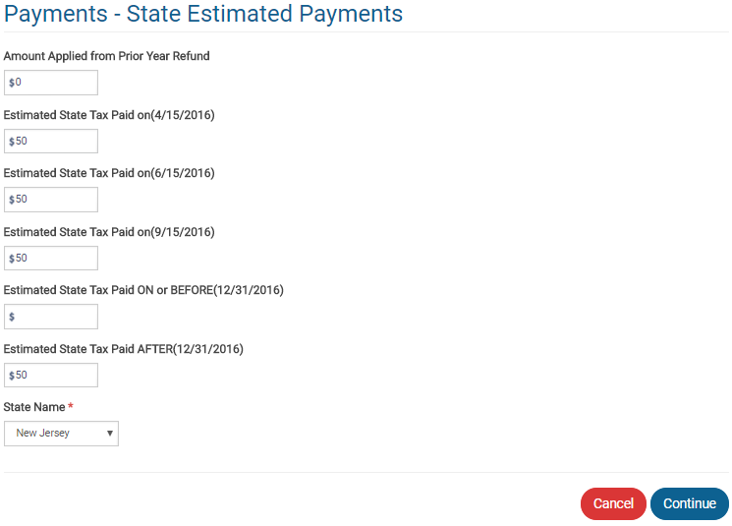
TS - NJ Estimated Taxes Paid and Amount Applied from Prior Year Federal Section \ Payments and Estimates \ State Estimated Payments
From prior year refund
NJ estimated tax payments
Enter final estimated tax payment on proper line
to show if payment made before or after 12/31
Notes:
7

Slide 8
NJ Estimated Tax Payments: What Amounts Are Transferred Where
Sch A Line 5a State & Local Taxes includes payments made in current tax year for any year’s tax due:
2016 estimated tax payments paid in 2016 only
From State Estimated Taxes screen
Refund from 2015 return applied to 2016
From State Estimated Taxes screen
2015 (or prior) tax payments paid in 2016
From Itemized Deductions \ Taxes You Paid screen
Final 2015 estimated tax payment paid in January 2016
From Itemized Deductions \ Taxes You Paid screen
NJ 1040 Line 50 includes payments applied to current year’s tax due, no matter when paid:
2016 estimated tax payments paid in 2016 or 2017
Refund from 2015 return applied to 2016
Notes:
8

Slide 9
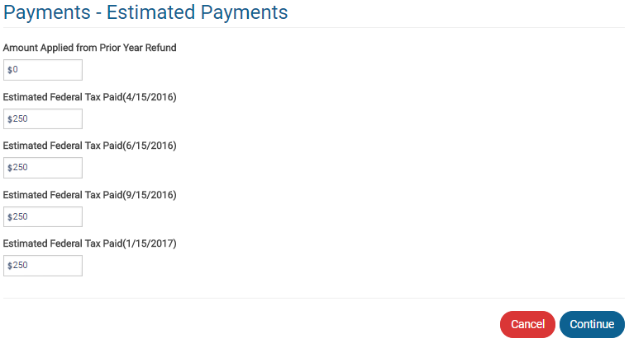
TS – State Estimated Payments Screen – Schedule A Amount (Amounts Paid in 2016)
TaxSlayer totals & transfers to Schedule A Line 5a
Not transferred to Schedule A Line 5a
because it was not paid in 2016
Notes:
9

Slide 10
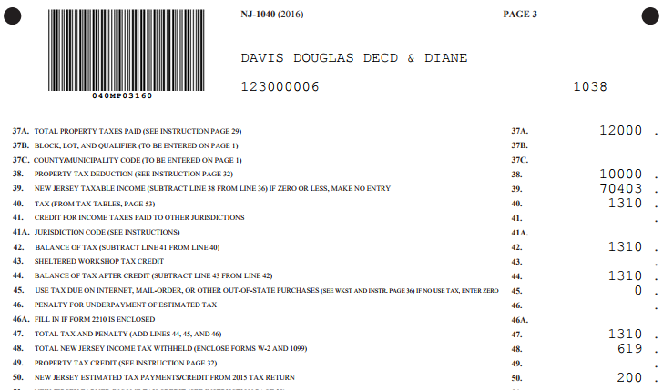
TS - NJ 1040 Line 50 – State Estimated Taxes Paid and Amount Applied from Prior Year (No Matter When Paid)
Current year NJ estimated tax payments (no
matter when paid) and amount applied from
prior year refund
Notes:
TaxSlayer will transfer total of last year’s refund applied to current year + NJ estimated tax payments to NJ 1040 Line 50
10

Slide 11
Payments Made With Extension of Time To File - Federal 1040 Line 70 / NJ 1040 Line 50
Taxpayer requests extension of time to file
Must pay estimated balance due with extension request
Must be sent by regular tax filing date
Complete Federal Form 4868
Complete NJ Form 630
Amount paid with extension is reported on 1040 Line 70 or NJ 1040 Line 50 when final return is filed later
Cannot be e-filed. Must be sent via mail
Must submit final return by Oct. 15
Notes:
11

